Slide 1



Temperature Based Automatic Regulator Using Arduino
FINAL REVIEW
PRESENTED BY:
B . Sathiyadharshini (927621BEC190)
GUIDED BY:
Mrs. T. Abirami,
AP/ ECE
DATE : 13.10.2023

Slide 2
LIST OF CONTENTS
INTRODUCTION
PROBLEM STATEMENT
OBJECTIVE
BLOCK DIAGRAM
EXISTING SYSTEM
PROPOSED SYSTEM
COMPONENTS
WORKING PRINCIPLE
CONCLUSION
REFERENCES

Slide 3
INTRODUCTION
The idea behind the project is to control the speed of the fan by difference in temperature. It is a process in which the objects temperature is measured and the way of heat energy passes into or out of the object is correctly adjusted to achieve a stable temperature.This project attendances the design and simulation of the fan speed system by using PWM technique based on the room temperature. The room temperature can be measured with the help of a Temperature Sensor. It has been used to measure the temperature of the room and the speed of the fan is varied according to the room temperature using Pulse Width Modulation technique.

Slide 4
PROBLEM STATEMENT
Most human feels the badly designed about changing the fan rate level physically when the room temperature changes. Along these lines, the programmed fan framework that consequently changes the velocity level as indicated by temperature changes is prescribed to be fabricated for tackling this issue

Slide 5
OBJECTIVE
Temperature Based Fan Controller can be used for reducing the power consumption & also to assist people who are disabled and are unable to control the speed of fan . It may also be used for monitoring changes in environment.
Temperature monitoring systems generate accurate temperature data. With precise temperature data, it's easy for the logistics department to regulate their workflow and maintain the temperature standards.

Slide 6
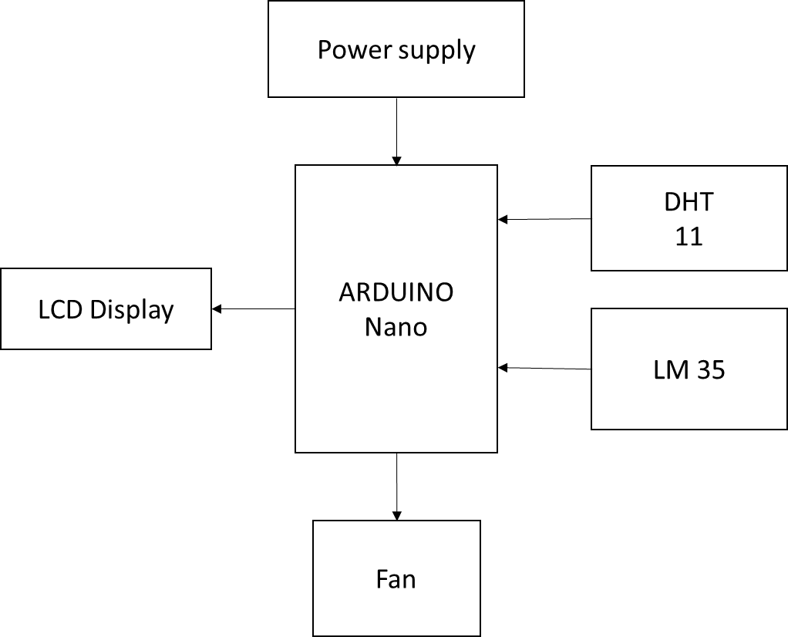
BLOCK DIAGRAM

Slide 7
EXISTING SYSTEM
There are many methods to control the speed of the fan and one of the method is regulator.It control the fan speed which is manually processed by human.
When the technology was improved the people are changed to remote control to control the speed of the fan and also using the google assistant.

Slide 8
PROPOSED SYSTEM
In this system we don’t use any regulator or google assistant to control the fan speed. Here we using the temperature sensor and it will automatically sense the room temperature based on the weather.
This system doesn’t need any mannual operation. It will take the input itself and operate the fan based on the temperature.

Slide 9
COMPONENTS
ARDUINO NANO
FAN
LCD DISPLAY
L7805
POWER SUPPLY
POTENTIO METER
DHT 11
LM35

Slide 10
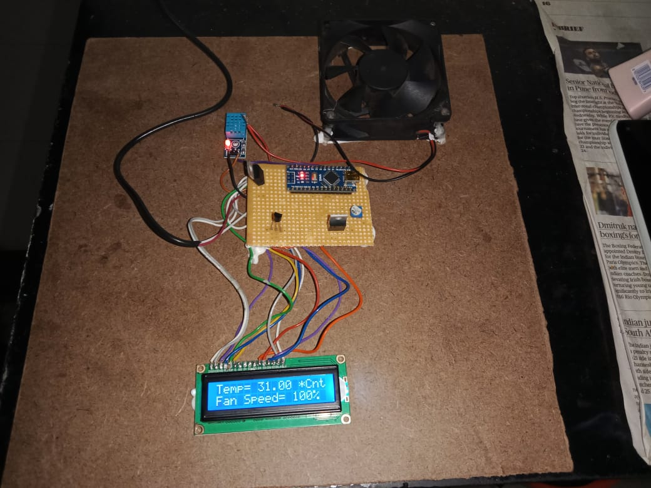

Slide 11
WORKING PRINCIPLE
In a temperature-based automatic regulator using Arduino, temperature data is acquired through a DHT11 and an LM35 sensor, with a L7805 voltage regulator ensuring stable power supply. The user-configurable setpoint is established using a 201-type potentiometer, and real-time temperature values are displayed on an LCD screen, providing immediate feedback to the user. The Arduino processes the temperature data, comparing it to the setpoint; if the temperature falls outside the desired range, the system activates either a heating or cooling element to maintain the set temperature, ensuring efficient climate control in the monitored environment.

Slide 12
CONCLUSION
The Temperature Based Automatic Regulator Using Arduino is a useful project that can be used to control the speed of a fan based on the temperature of the room. The system can be controlled remotely using a mobile phone or a computer, making it easy to use. The system can be used to improve the comfort level in a room by automatically adjusting the fan speed based on the temperature.

Slide 13
REFERENCES
[1]. Liu, Y., Zeng, J. and Wang, C. (2009). Temperature Monitoring in Laser Assisted Polymer Bonding for MEMS Packaging Using a thin Film Sensor Array , IEEE Sensors Applications Symposium, New Orleans, LA , USA.
[2]. Jung, W.,You, J. and Won, S. (2008). Temperature Monitoring System for Inductive Heater Oven (pp.1734-1737), International Conference on Control, Automation and Systems, Seoul Korea.
[3]. Mehta V. K and Mehta R. (2007). Principle of Electronics, S.Chand & Company Ltd.New Delhi, 438
[4]. Theraja B. L and Theraja A. K. (2002). A Textbook of Electrical Technology, S. Chand &Company Ltd. New Delhi, 2105

Slide 14


